Slide 1

Viva Connections & SharePoint Framework Bi-weekly sync
aka.ms/m365pnp
Your host in this call: Patrick Rodgers
Call begins at 7:00 AM PT / 3:00 PM GMT
July 14th, 2022
Microsoft 365 PnP Team

Slide 2
Viva Connections & SharePoint Framework Bi-weekly sync
aka.ms/m365pnp
July 14th, 2022
Microsoft 365 PnP Team

Slide 3




Agenda
Patterns and Practices Updates
PnPjs
CLI for Microsoft 365
Reusable PnP SPFx controls
New Community Samples
Picture time with Together Mode!
Demos
Don Kirkham – Upgrading SPFx solutions to the latest version using the CLI for Microsoft 365
Siddharth Vaghasia – Adaptive Card Extensions – Dynamic Announcements

Slide 4
Opportunities to Participate in PnP SPFx / JS SIG
SPFx Demo
@pnp Demo
Contribute on GitHub
Provide Feedback
Web Part
Application Customizer
Provisioning
Anything you create!
PnPjs
CLI for Microsoft 365
SPFx Reusable Controls
SPFx Community Yeoman
Report Issues
Submit Pull Requests
Help with issues/questions
How are the calls?
Documentation needs?
Where can we help?
Positive is OK too!
Great opportunity to get visibility for you or your company. Demo sample or explain how you extend or customize SharePoint Online with live demo in your projects. Reach out to team for volunteering.
Request a demo spot on the call
https://aka.ms/m365pnp/request/demo

Slide 5
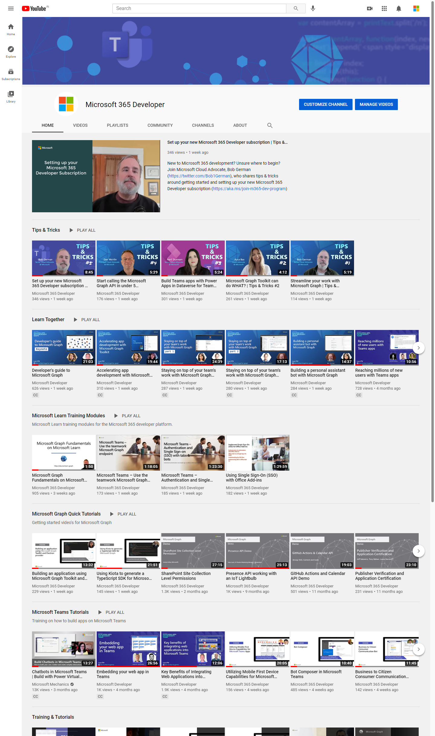
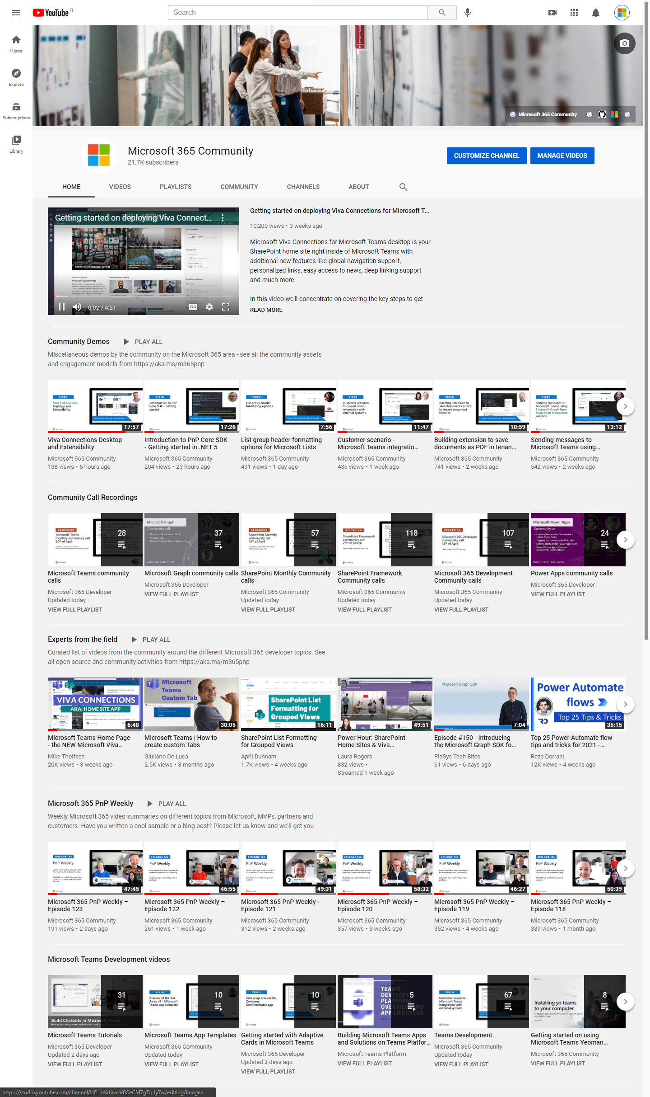
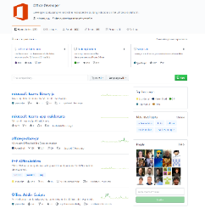
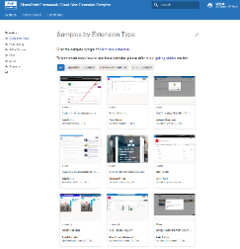
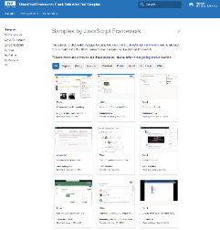
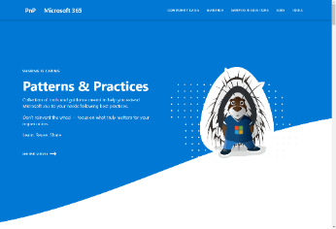
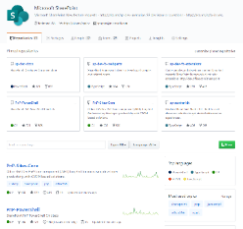
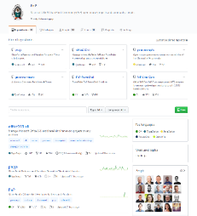
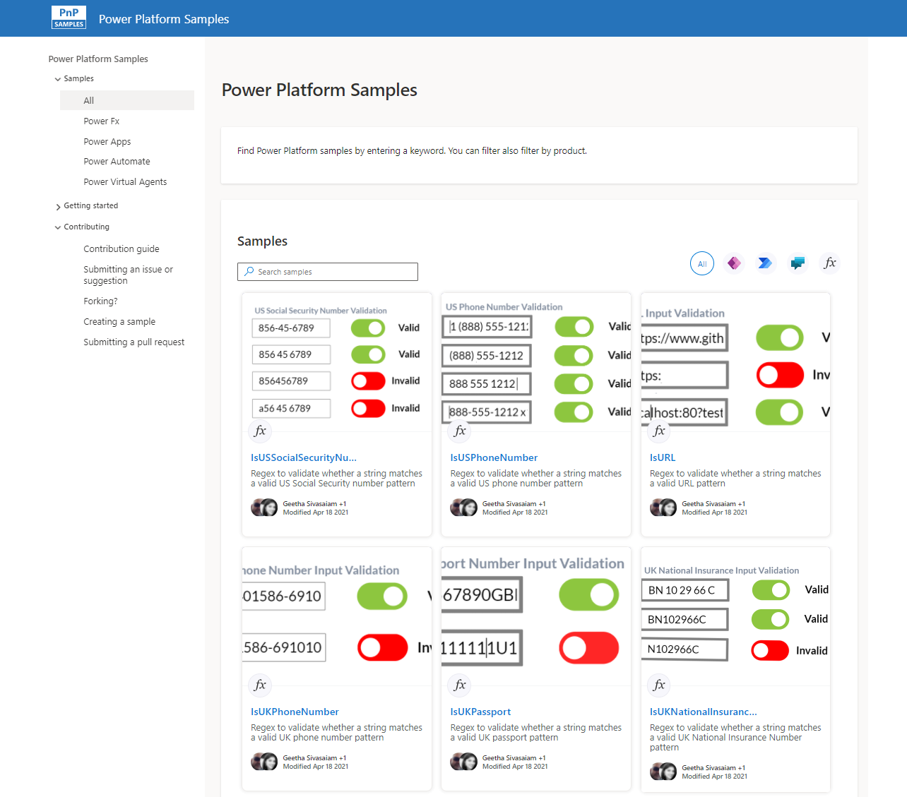
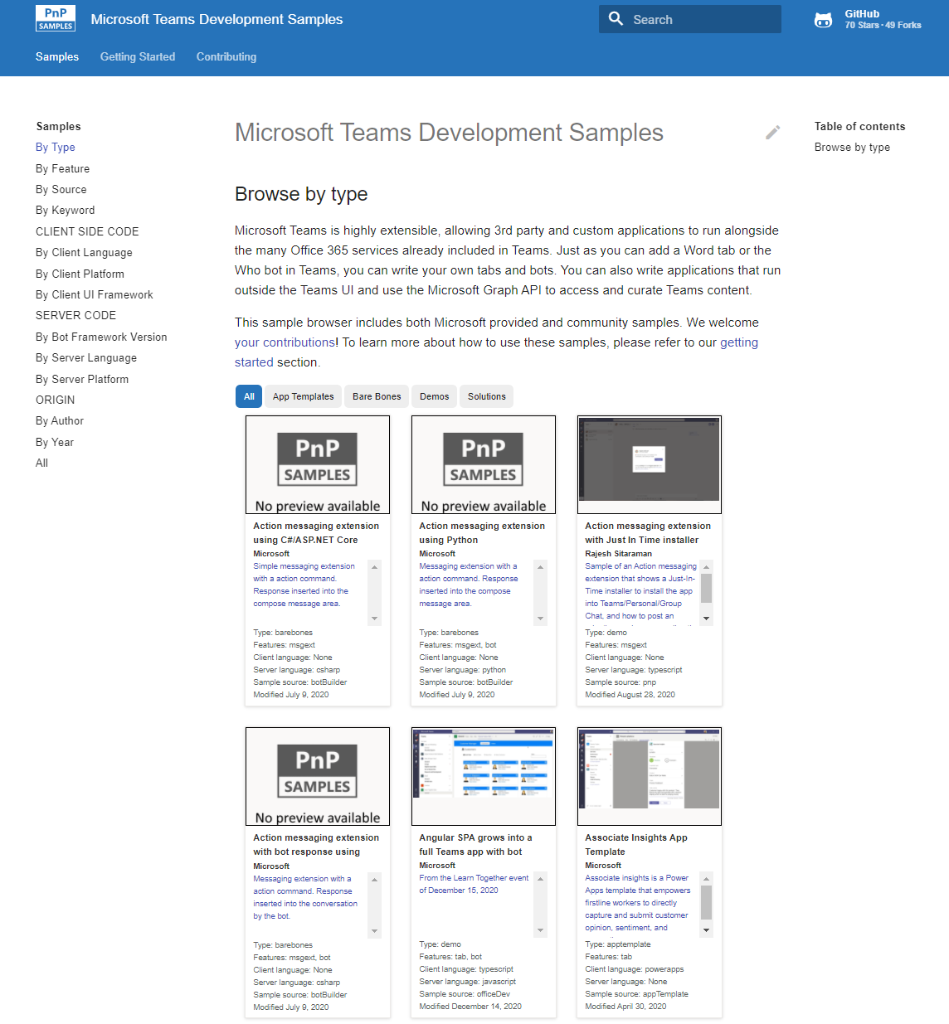
Microsoft 365 developer videos
Microsoft 365 community videos
Open-source
Sample galleries
Open-source initiatives and samples
aka.ms/m365devyoutube
aka.ms/m365/videos
github.com/pnp
github.com/officedev
github.com/microsoftgraph
github.com/sharepoint
aka.ms/m365/samples
aka.ms/teams-samples
aka.ms/spfx-webparts
aka.ms/spfx-aces
aka.ms/powerplatform-samples
aka.ms/spfx-extensions
aka.ms/list-formatting
aka.ms/m365/community
@Microsoft365Dev | @m365pnp
One URL to rule them all…

Slide 6
Microsoft 365 developer community calls
Microsoft 365 platform (weekly) https://aka.ms/m365-dev-call
(Notice. This call is on a summer break between July 1st and 31st of August 2022)
Adaptive Cards https://aka.ms/adaptivecardscommunitycall
Microsoft identity platform https://aka.ms/IDDevCommunityCalendar
Office Add-ins https://aka.ms/officeaddinscommunitycall
Power Platform https://aka.ms/PowerPlatformCommunityCall
Microsoft 365 and Power Platform community (bi-weekly) https://aka.ms/m365-dev-sig
Viva Connections & SharePoint Framework (bi-weekly) https://aka.ms/spfx-call
Download recurrent invites from
https://aka.ms/m365/calls
Notes:
m365-dev-sig

Slide 7

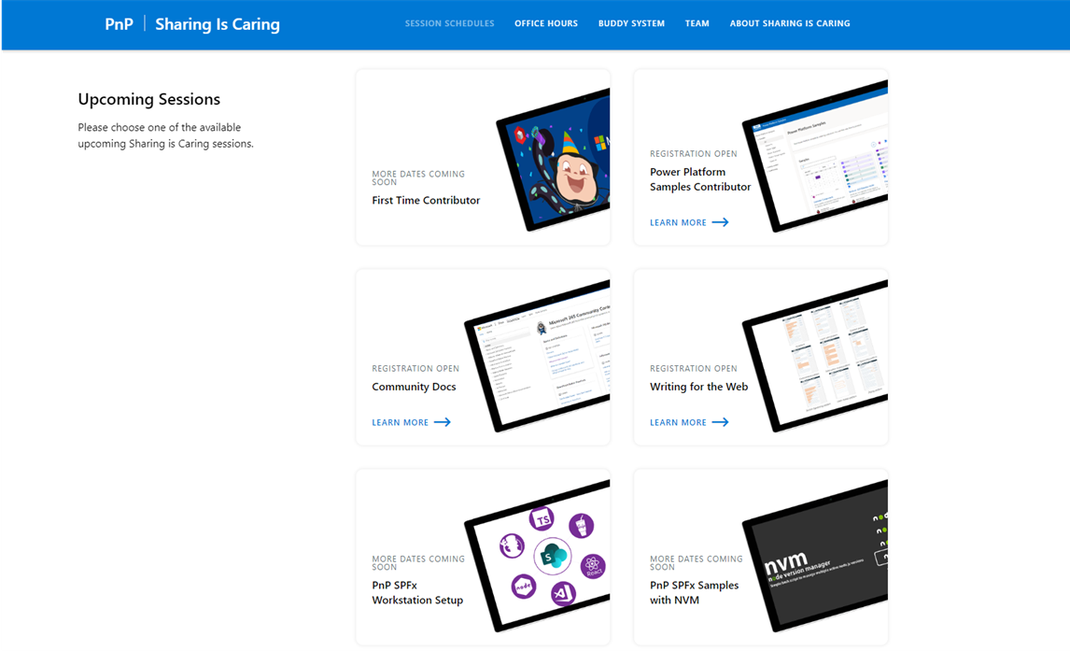
GUIDANCE
Learn how to get started in the open-source PnP community!
Upcoming Sessions:
First-time contributor
Writing for the Web
Community docs
Using PnP SPFx samples w/ NVM
SPFx developer workstation setup
More than code with VS Code
First-time presenter
M365 Maturity Model Practitioners
Power Platform Samples Contributor
NEXT WEEK!!!
https://aka.ms/sharing-is-caring
Notes:
25 Total attendees, 16 attendees who attended both First-Time Contributors and Community Docs sessions.

Slide 8





COMMUNITY
Recognition Program
Showcase your contributions
Powered by Credly
More achievement levels coming soon
https://aka.ms/m365pnp-recognition
Notes:
25 Total attendees, 16 attendees who attended both First-Time Contributors and Community Docs sessions.

Slide 9

PnPjs Client-Side Libraries

Slide 10
























PnPjs Client-Side Libraries
Version 3.5 released July 12th & 3.5.1 July 13th
General documentation updates
Fix for WebPartContext typing change in SPFx 1.15
Beta-2 release of cancellable fetch calls
Tenant Admin support with new package (sp-admin)
Updates lists IRenderListDataParameters & RenderListDataOptions with new values not present originally
Fix for with reviewing caching and batching.
Regression fix for the queryable constructor
Don’t forget about the nightly builds
npm install @pnp/sp@v3nightly --save
Docs: https://pnp.github.io/pnpjs/ @m365pnpjs on twitter

Slide 11
CLI for Microsoft 365

Slide 12
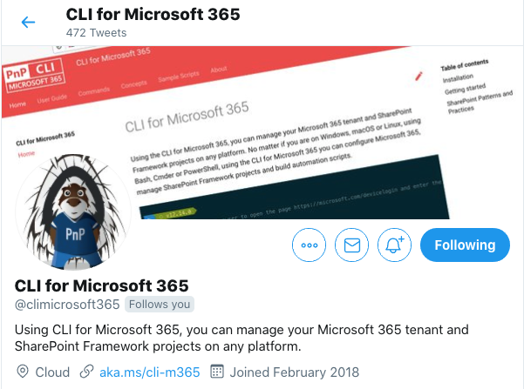
CLI for Microsoft 365
New beta v5.5 with:
Removing Teams cache
Extended SPFx development environment and project diagnostics with support for SPFx 1.15
@meId and @meUserName tokens to simplify passing current user's ID and name to commands
Extended creating new Planner plans
Extended managing Microsoft Teams teams
...and more!
Install v5.5 beta:
npm install -g @pnp/cli-microsoft365@next
docker run --rm –it m365pnp/cli-microsoft365:next
Release notes:
https://pnp.github.io/cli-microsoft365/about/release-notes/#v550
@climicrosoft365 #CLIMicrosoft365 on Twitter
📖 aka.ms/cli-m365
🗣 github.com/pnp/cli-microsoft365/discussions
Notes:
Introduce yourself - "Hey everyone 👋 Its Garry here from the CLI team"
High level - "We have been busy adding new capabilities to CLI for Microsoft 365 v5.5 beta which we will release at the end of the month"
Summary - "In this release we have new commands and enhancements across Planner, SPFx and Teams, as well as general improvements and bug fixes. Most notably we have added a new command that will help clear your Microsoft Teams client cache, supporting the Windows, macOS and Linux clients"
CTA (engage) - "I have provided some links in the chat for you to access all the key resources surrounding this release"
CTA (check docs) - "please checkout the release notes for further detail on what has been included so far"
CTA (install) - "If you want to try out the beta version, you can install directly from npm, or alternatively use our Docker image to run CLI in a container"
CTA (follow us) - "If you want to keep up with the latest CLI announcements, I recommend that you can follow our Twitter account @climicrosoft365"
CTA (feedback) - "If you have any feedback (both positive and negative) or ideas for new features that you'd like to see, then please checkout the GitHub repo, and either raise an issue or start a discussion, we would absolutely love to hear from you"
Closing (Thank you) - "Finally, thank you to all the contributors who made this release possible. That’s all for now, thank you"
📝 Release notes - CLI for Microsoft 365 (pnp.github.io)
🧹 cache remove - CLI for Microsoft 365 (pnp.github.io)
📦 @pnp/cli-microsoft365 - npm (npmjs.com)
🐳 Run CLI in a Docker Container - CLI for Microsoft 365 (pnp.github.io)
💬 CLI for Microsoft 365 (@climicrosoft365) / Twitter
💻 pnp/cli-microsoft365: Manage Microsoft 365 and SharePoint Framework projects on any platform (github.com)

Slide 13
SPFx Reusable Components

Slide 14
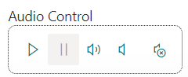
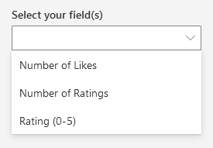
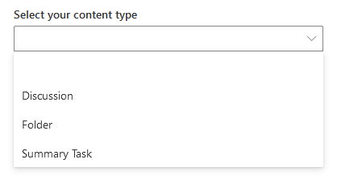
Reusable SPFx Controls
React Controls – 3.9.0
New controls: EnhancedThemeProvider, FieldPicker, ContentTypePicker, ModernAudio, AdaptiveCardDesignerHost
Enhancements to DateTimePicker, Toolbar, PeoplePicker, DynamicForm
Various fixes
Release notes: https://pnp.github.io/sp-dev-fx-controls-react/about/release-notes/
React Property Controls – 3.8.0
Localization for en-gb
Enhancements for fast-serve, PropertyFieldSitePicker, PropertyFieldCollectionData
Various fixes
Release notes: https://pnp.github.io/sp-dev-fx-property-controls/about/release-notes/
Special thanks to our contributors: Annie-Johnson, Daniel Watford, Dennis Kuhn, Fabio Franzini, Gautam Sheth, Jake Stanger, Jasey Waegebaert, Joseph Halvey, IRRDC, Markus Langer, Markus Möller, Milan Holemans, Morten Andersen, Peter Cox, Richard Gigan, Rico van de Ven, ryanexner, Sergio Villalta.
More information:
https://sharepoint.github.io/sp-dev-fx-property-controls https://sharepoint.github.io/sp-dev-fx-controls-react
Twitter: @M365PnPControls

Slide 15
PnP Modern Search

Slide 16
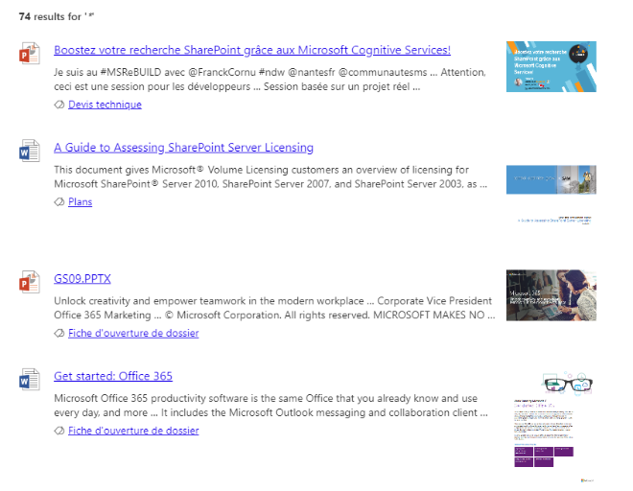

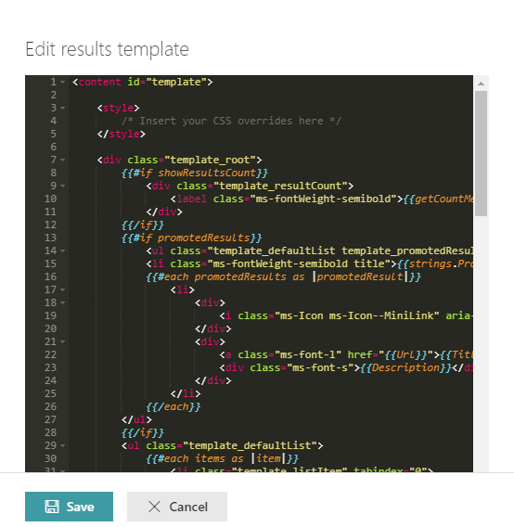
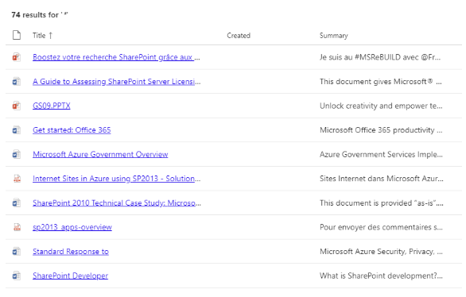

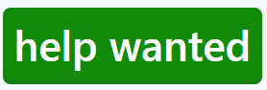
PnP Modern Search
http://aka.ms/pnp-search
Building modern Search experiences with flexible web parts
v4.7.0-beta – June 2022 release
https://github.com/microsoft-search/pnp-modern-search/releases/tag/4.7.0-beta
Thank you @d-martins, @bruzie, @rick-brown-slalom, @mrjarbenne, @davemehr for your support
Support for Adaptive Card rendering
See release notes for fixes and new features
v3.23.0 – December 2021 release
https://github.com/microsoft-search/pnp-modern-search/releases
See release notes for fixes and new features
Notes:
https://github.com/microsoft-search/pnp-modern-search

Slide 17

PnP SPFx Samples

Slide 18
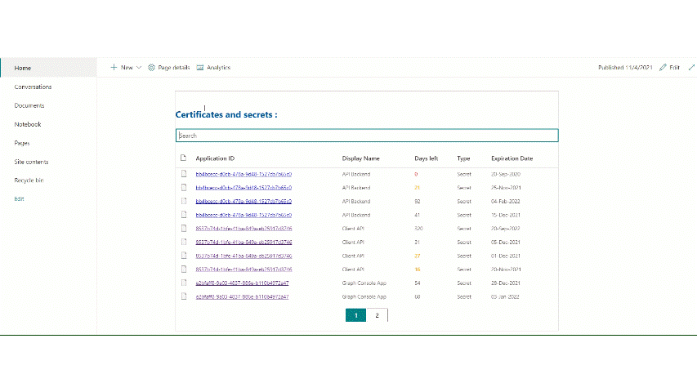
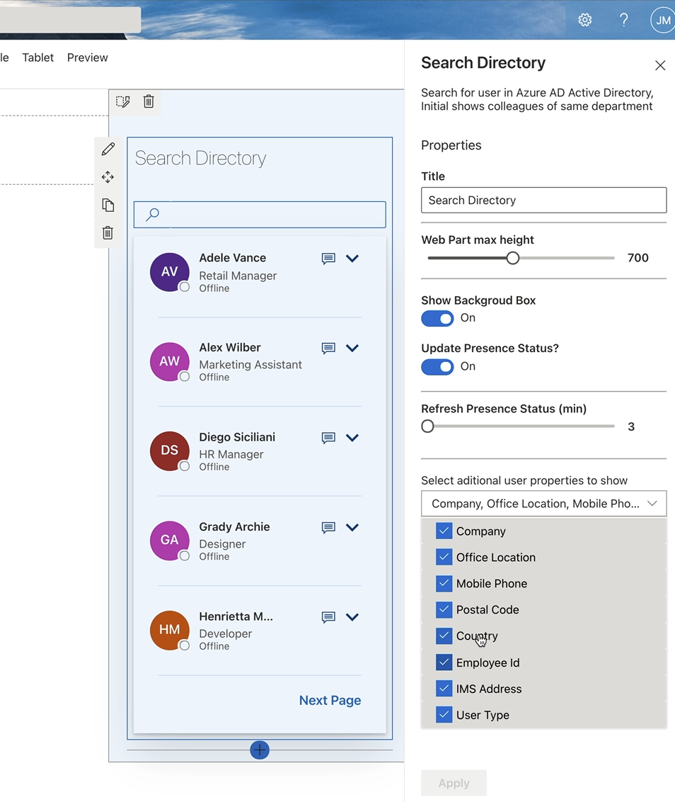
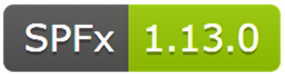
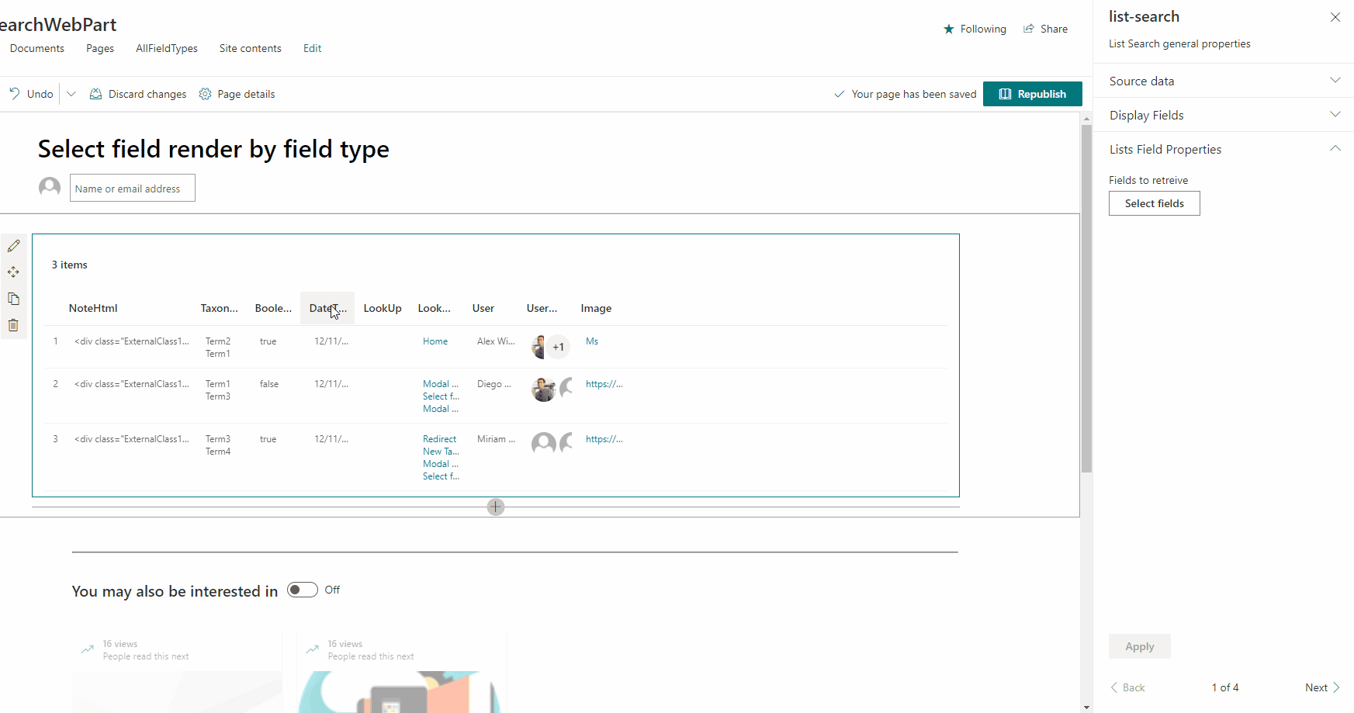
PnP SPFx Samples
PnP SPFx Samples
PnP SPFx Samples
https://aka.ms/spfx-extensions
Contributions welcome
https://aka.ms/spfx-webparts
Page Navigator Jasey Waegebaert | Jwaegebaert
Applications Secrets Expiration Aimery Thomas| @aimery_thomas
List Search Aaron B.| mackilroy007
Follow Documents André Lage | @aaclage
Notes:
SPFx extensions https://aka.ms/spfx-extensions
NOPE
SPFx web parts https://aka.ms/spfx-webparts
Page Navigator
Jasey Waegebaert | Jwaegebaert This PR will fix the heading links which contain a lot of spaces between words and caps the heading length at 128 chars. Also cleaned up the regex a bit, because it was starting to get messy.
https://github.com/pnp/sp-dev-fx-webparts/tree/main/samples/react-page-navigator
Applications Secrets Expiration Aimery Thomas| @aimery_thomas
Upgraded SPFx to 1.15
https://github.com/pnp/sp-dev-fx-webparts/tree/main/samples/react-graph-app-secret-expiration
List Search Aaron B.| mackilroy007
Fixing pre-existing CAML query issue, previously mentioned in react-list-search CAML query issue #1804, by including missing CAML query results where its currently missing.
The present CAML query option where not fully/correctly implemented, failing to display the results injected CAML queries or List view settings if inserted by the user. As a result no values inserted within the source data CAML properties or list view title where returned, rendering both of the other features incorrectly.
https://github.com/pnp/sp-dev-fx-webparts/tree/main/samples/react-list-search

Slide 19
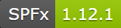
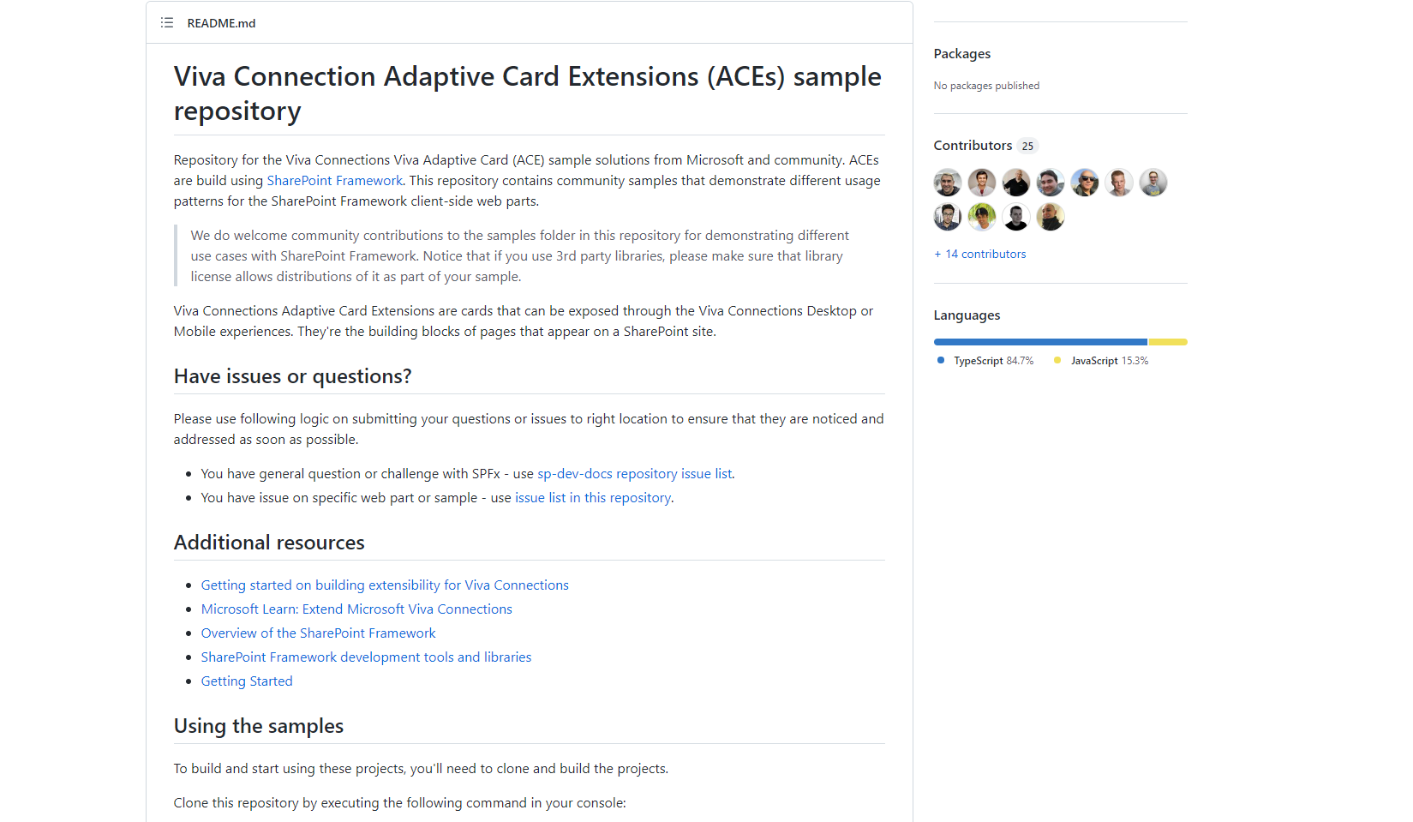
PnP SPFx ACEs
PnP SPFx Samples
PnP SPFx Samples
https://aka.ms/spfx-aces
*** We Love New Samples ***
Sharing is Caring Session
*** Coming Soon ***
Follow Documents André Lage | @aaclage
Notes:
This adaptive card extension sample demonstrate ability to monitor security risks using identity protection graph api from Viva Connection Dashboard
SPFx extensions https://aka.ms/spfx-extensions
Copy/Move Items within Lists Sudharsan Kesavanarayanan | @sudharsank This application customizer will display a command button named Copy/Move Item(s) in all the custom lists. Using this option, the items can be copied or moved from one list to another within the site.
https://github.com/pnp/sp-dev-fx-extensions/tree/main/samples/react-command-copy-move-items
SPFx web parts https://aka.ms/spfx-webparts
Applications Secrets Expiration Aimery Thomas | @a1mery This sample web part shows the list of your applications registered in Azure AD along with their associated client secret/certificate expiration date. https://github.com/pnp/sp-dev-fx-webparts/tree/main/samples/react-graph-app-secret-expiration

Slide 20



Optional picture time!
Video on and we’ll grab a Together Mode pic with those who are willing to do this.
We are together on this as a community!
Let’s all be like Seb?
By enabling your camera for the picture, you grant us permission to share your picture in social media.

Slide 21

DEMO
Upgrading SPFx solutions to the latest version using the CLI for Microsoft 365 – Don Kirkham
Adaptive Card Extensions - Dynamic Announcements – Siddharth Vaghasia

Slide 22
Thank you
Recording will be available in 24 hours on
Microsoft 365 Community (PnP) YouTube channel
https://aka.ms/M365/videos
(subscribe today)
Follow us on Twitter
@Microsoft365Dev | @M365PnP
Next Viva Connections & SPFx call: July 28th at 07:00am PT
Next M365 General Dev call: July 21st at 07:00am PT
All available community calls from https://aka.ms/m365/calls

Slide 23


aka.ms/m365pnp

